Slide 1


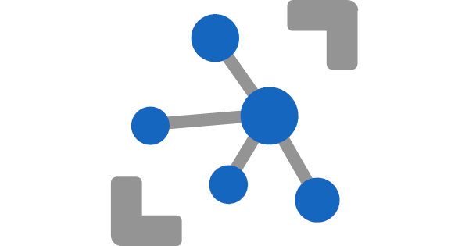


IoT4Solution/Smart Start2 using - Azure IoTHub, - Azure Stream Analytics - and Azure SQL
Meinrad Weiss
SR Cloud Solution Architect
06.04.2022

Slide 2
Agenda
Goal and Solution Overview
Deploy Solution
Internals
Auto Signal Registration
Handle Duplicate Values
Storage Details
Poor man’s digital twin
Restrict Data Access
Efficient Queries
Monitor activity/reset the database
Database Tiers
Conclusion and next Steps

Slide 3
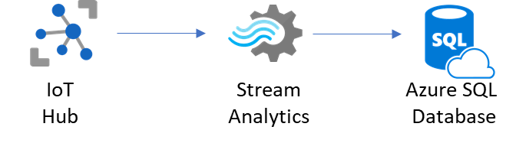
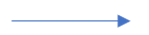
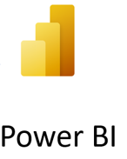

Slide 4
Goal
The goal of the training is to share real live experience from some IoT projects
Understand the purpose of the used Azure Services
Azure Storage Account
Azure IoT Hub
Azure Stream Analytics Job
Azure SQL Database
To enable you to setup POC environments with just a few clicks
We share not only our knowledge but also a GitHub repo with blueprints that are ready to be deployed
To get a POC environment that is (close to) production quality
To have fun ☺

Slide 5
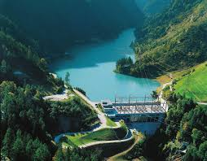


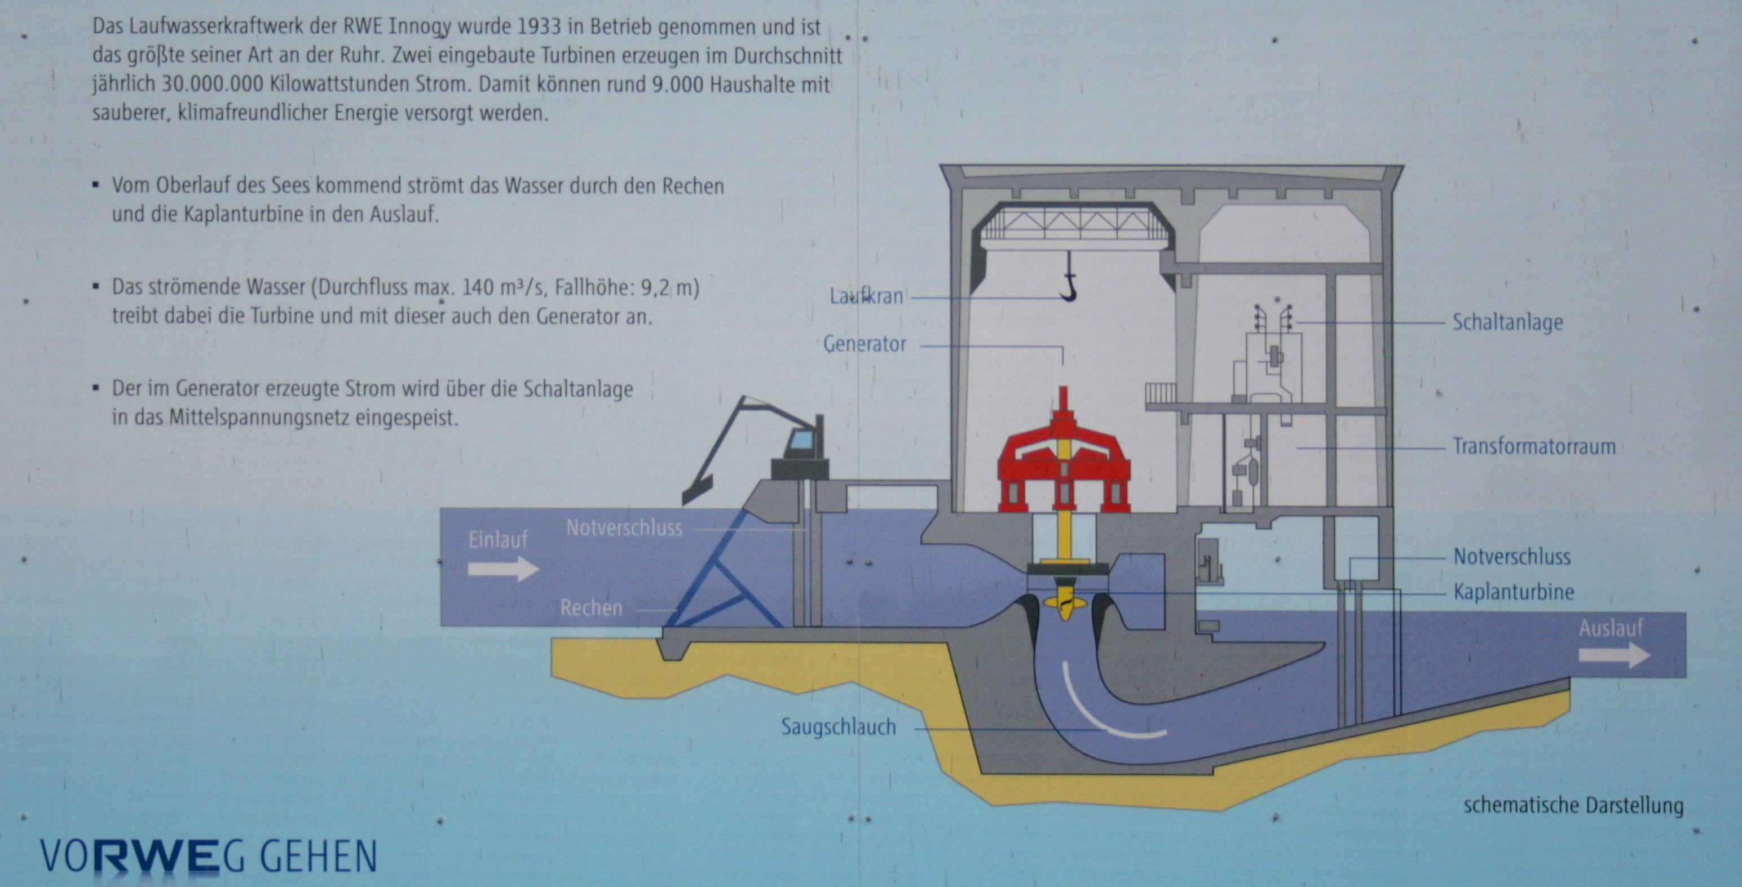


Source of the Architecture (Axpo Hydro)
IoT Edge
IoT Hub
Stream Analytics
Azure SQL Database
Web
Application
Reference
Data
Azure
Machine
Learning
Third
Party
+ 3 Projects @ Axpo Grid
+ 1 Project @ Emost (Axpo)
+ 1 Project @ Migros

Slide 6
Main goals/requirements and features
Optimal ingest and query performance
Minimal impact if database grows
Use PaaS services and functionality
Auto registration of new Devices/Signals
Avoid duplicate delivery of events
(Keep them for quality control)
Deal with mal formed events
(Keep them for quality control)
Show data only allowed rows, company internal but also for third party users
IoT Hub
Stream Analytics
Azure SQL Database
Keep history of all security relevant meta data changes
Replace signal name with internal SignalId
(Tuned for efficiency)
Reference
Data

Slide 7
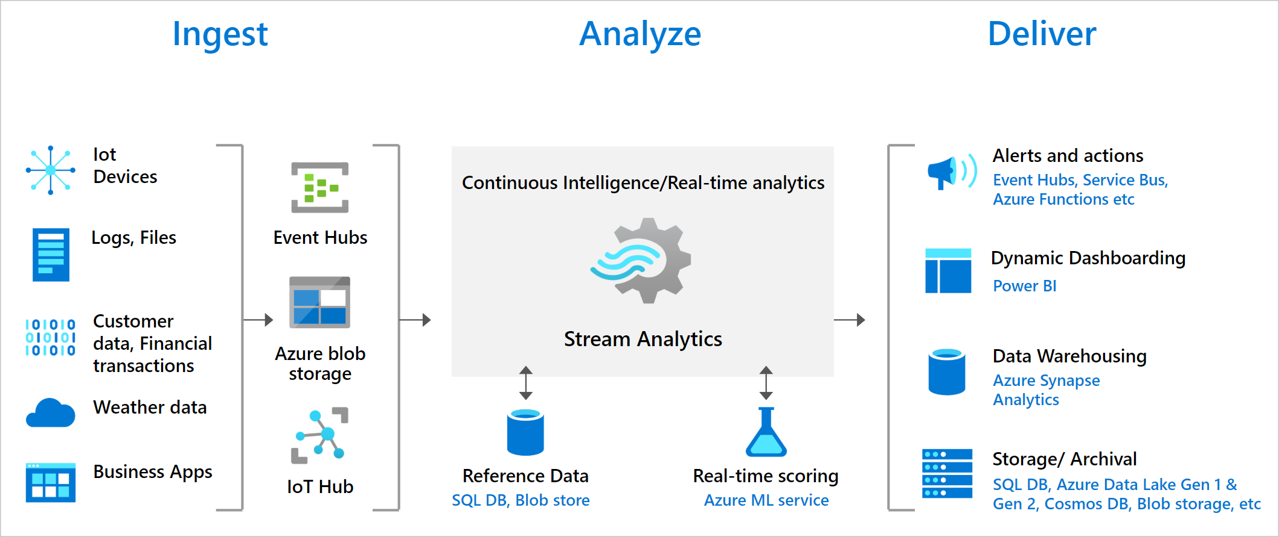
Azure Stream Analytics
Azure Stream Analytics is a real-time analytics and complex event-processing engine that is designed to analyze and process high volumes of fast streaming data from multiple sources simultaneously. Azure Stream Analytics | Microsoft Azure

Slide 8
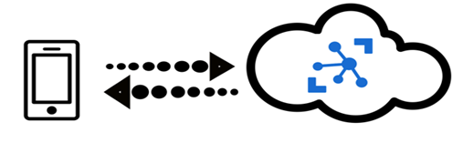
Azure IoT Hub (Edge)
IoT Hub is a managed service hosted in the cloud that acts as a central message hub for communication between an IoT application and its attached devices. You can connect millions of devices and their backend solutions reliably and securely. Almost any device can be connected to an IoT Hub.
Several messaging patterns are supported, including device-to-cloud telemetry, uploading files from devices, and request-reply methods to control your devices from the cloud. IoT Hub also supports monitoring to help you track device creation, device connections, and device failures.
Azure IoT Edge moves cloud analytics and custom business logic to devices so that your organization can focus on business insights instead of data management.

Slide 9
Data ingest and presentation
Avoid duplicate delivery of events
(Keep them for quality control)
Deal with mal formed events
(Keep them for quality control)
Show data only allowed rows, company internal but also for third party users
IoT Hub
Stream Analytics
Azure SQL Database
Keep history of all security relevant meta data changes
Replace signal name with internal SignalId
(Tuned for efficiency)
Reference
Data

Slide 10
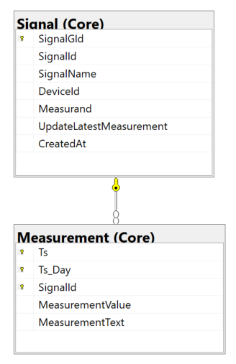
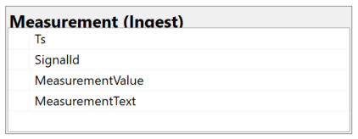
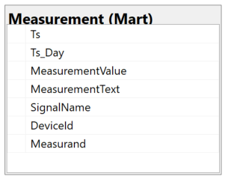
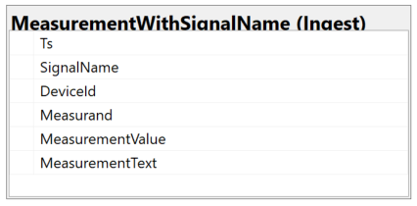
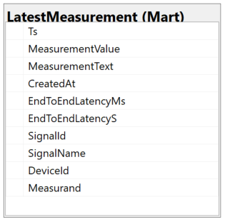
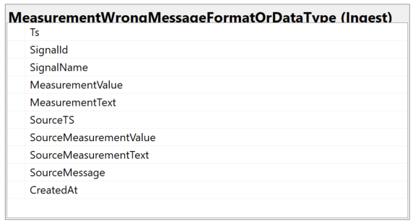
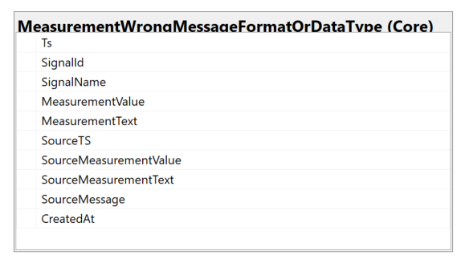
Main Azure SQL Database Structures
Ingest
Core
Mart
Stream Analytics

Slide 11
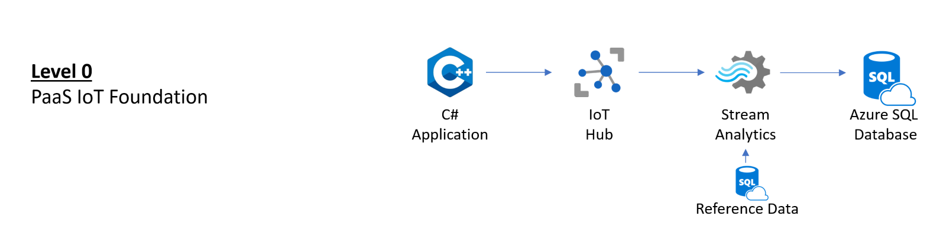

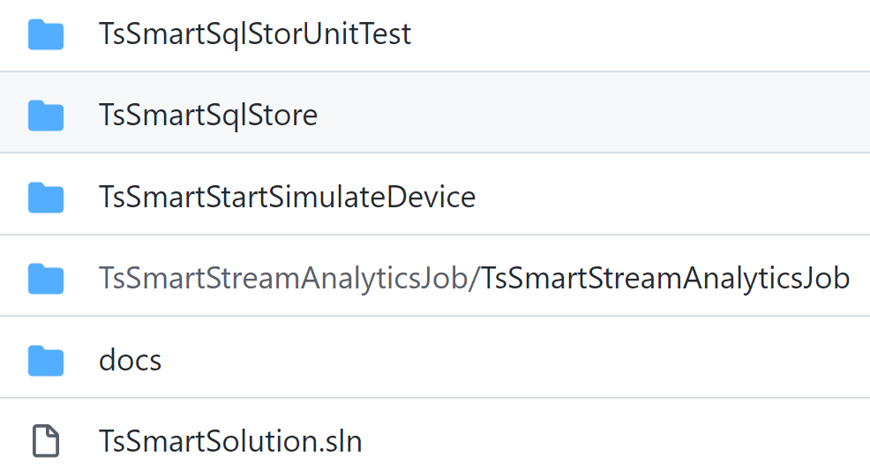
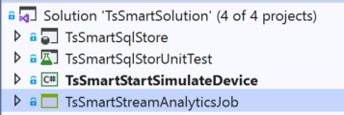
Deployment
3
2
1
1
2
0
Deploy Azure Services:
Azure Storage Account
Azure IoT Hub
Azure Stream Analytics Job
Azure SQL Database
Clone Git Repo to Visual Studio 2019/22
3
0
Clone
1
Deploy SQL Database Schema
2
Add Device & Configure C# Application
3
Define and Deploy Stream Analytics Job

Slide 12
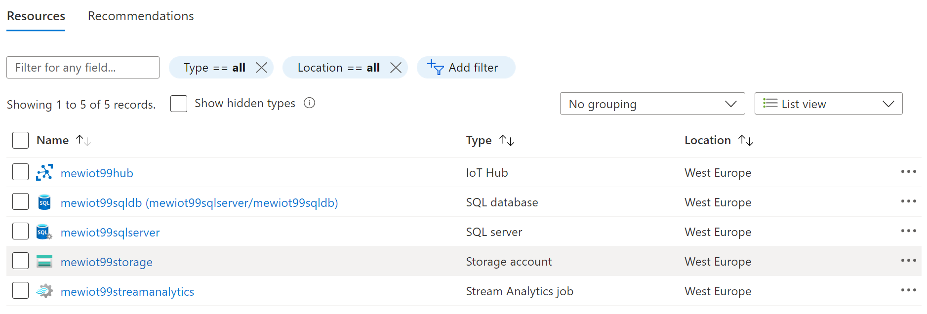
Deploy Azure Services
0
Deploy via commandline
To deploy to Azure via the commandline, first ensure you have the latest Azure CLI installed from here.
Make sure your subscription is set active:
Navigate your Shell to the folder of the ARM template.
To manually enter the necessary parameters during the deployment process run the following command:
az account set --subscription <yoursubscription>
az group deployment create --name <ExampleDeployment> --resource-group <YourResourceGroup> --template-file azuredeployBasic.json
uniqueSolutionPrefix
Notes:
az group deployment create --name <ExampleDeployment> --resource-group <YourResourceGroup> --template-file azuredeployBasic.json

Slide 13
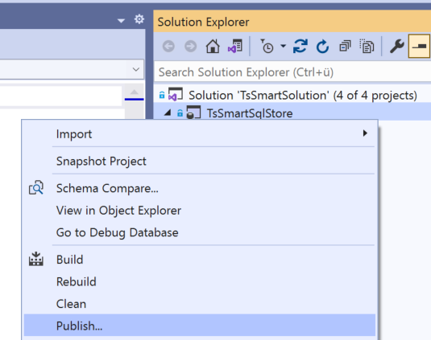
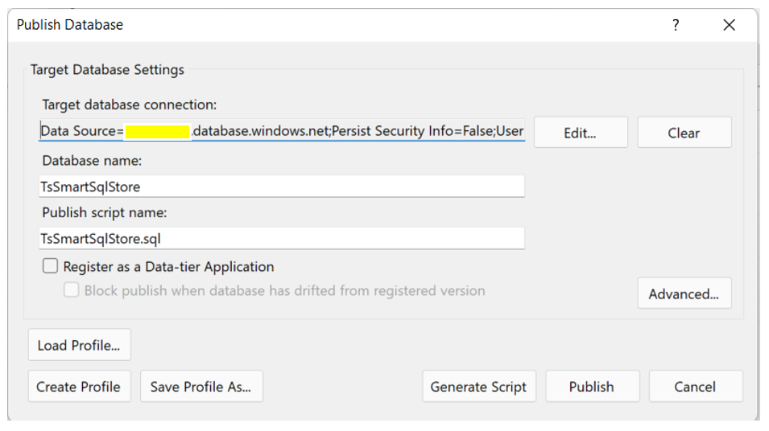
Deploy SQL Database Schema
1
Start Publish process
Define “target database connection:” and press [Publish]

Slide 14
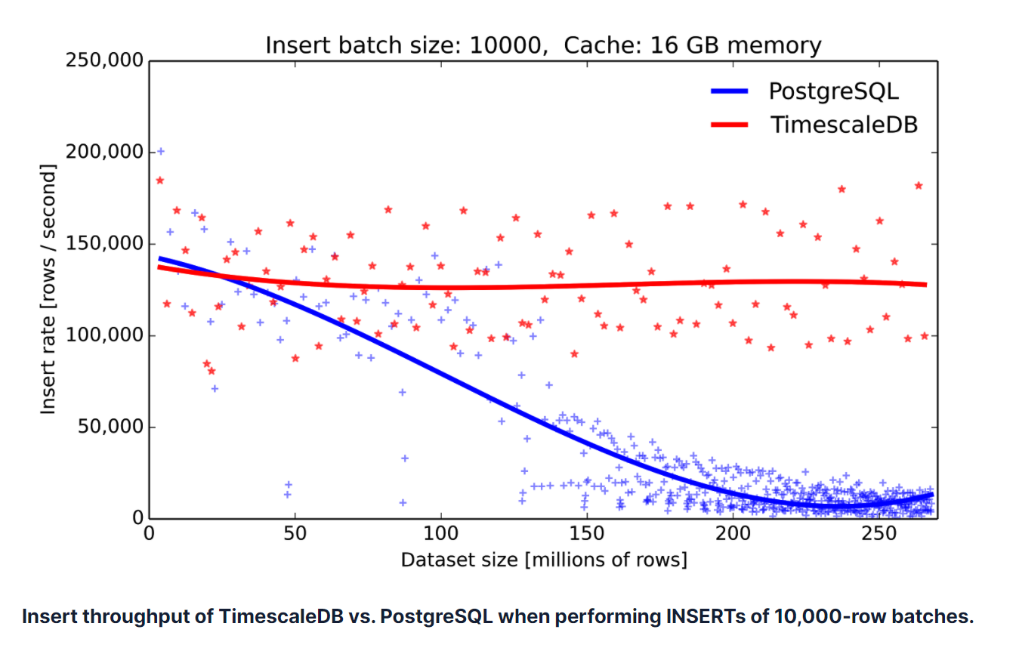


Adjust DB to your project
Source:
Time-series data: Why to use a relational database instead of NoSQL (timescale.com)
1
Goal
Partitions are key to keep performance at an optimal level, even if database is growing
One of the key features of TimescaleDB
Partition borders must cover the time range of the IoT data stored in the database
To maintain the partition border in the future a daily job must be setup (e.g., Data Factory, Synapse Pipelines, Logic App, Data Job, Airflow, Elastic DB Jobs (preview) …)
DECLARE @startDate date
DECLARE @dayAheadNumber int
SET @startDate = GETDATE() -- If we get data starting "today"
SET @dayAheadNumber = 35 -- Default
EXECUTE [Partition].[MaintainPartitionBorders] @startDate, @dayAheadNumber
Schedule once a day
EXECUTE [Partition].[MaintainPartitionBorders]

Slide 15
Adjust DB to your project - 2
1
1
2
Add “Stream Analytics” users to the database
Write process supports the usage of ‘managed identities’
Reading ‘Reference Data’ does not fully support managed identities
1
CREATE USER [<ASA_JOB_NAME>] FROM EXTERNAL PROVIDER;
GRANT SELECT, INSERT ON SCHEMA::INGEST TO [<ASA_JOB_NAME>];
2
-- In master database
CREATE LOGIN [ASA_MetaDataReader] WITH PASSWORD = '<your strong password 8fdKJl3$nlNv3049jsKK>';
-- In your IoT database -> Reading Meta Data does not support Managed Identity
CREATE USER [ASA_MetaDataReader] FOR LOGIN [ASA_MetaDataReader]
GRANT SELECT ON OBJECT::[Core].[Signal] TO [ASA_MetaDataReader] ; -- For test of ASA Job in Visual Studio -> It does not support Managed Identity
GRANT SELECT, INSERT ON SCHEMA::INGEST TO [ASA_MetaDataReader] ;

Slide 16
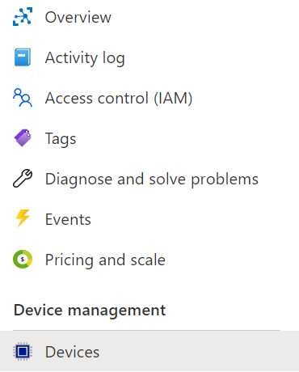
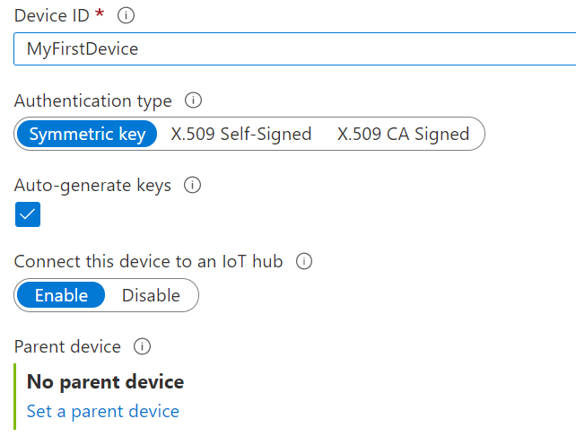
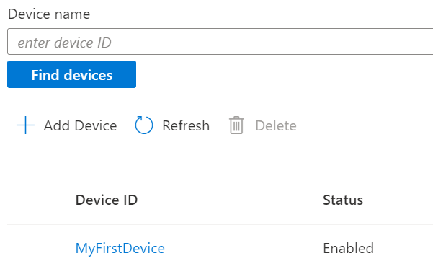
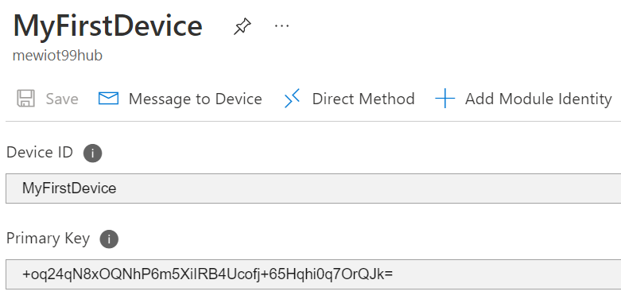
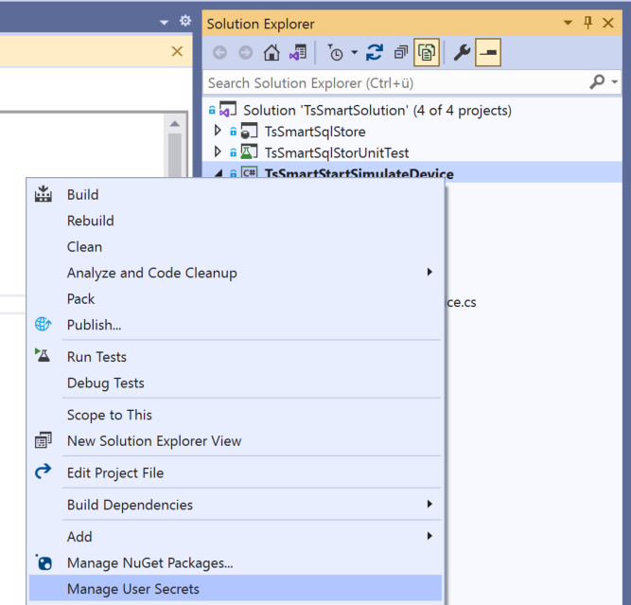
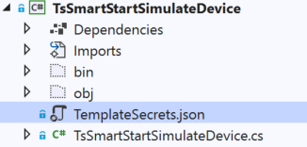
Add Device & Configure C# Application
2
Add device to your IoT Hub
Define the connection string to your IoT hub using ‘Manage User Secrets’
Template exits in the project folder
{
"HostName": "<yourIoTHubName> e.g. xxxx.azure-devices.net",
"DeviceId": "<yourIoTDeviceId>",
"SharedAccessKey": "<yourShareAccessKey>"
}

Slide 17
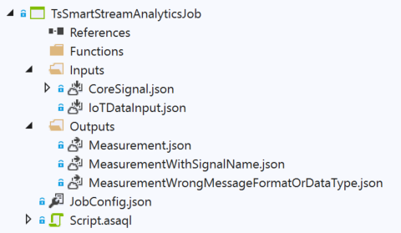
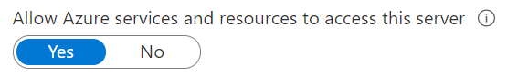
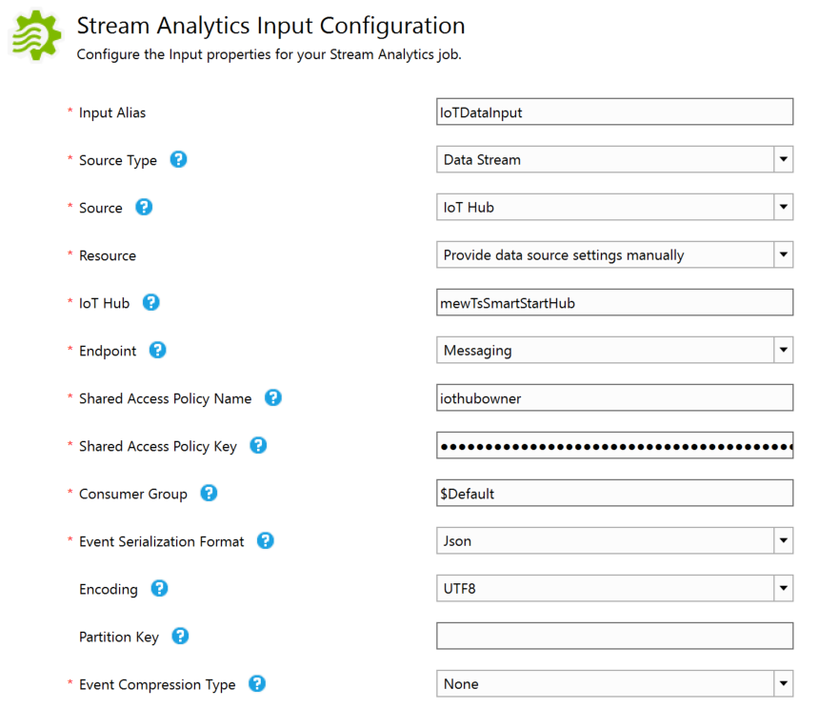
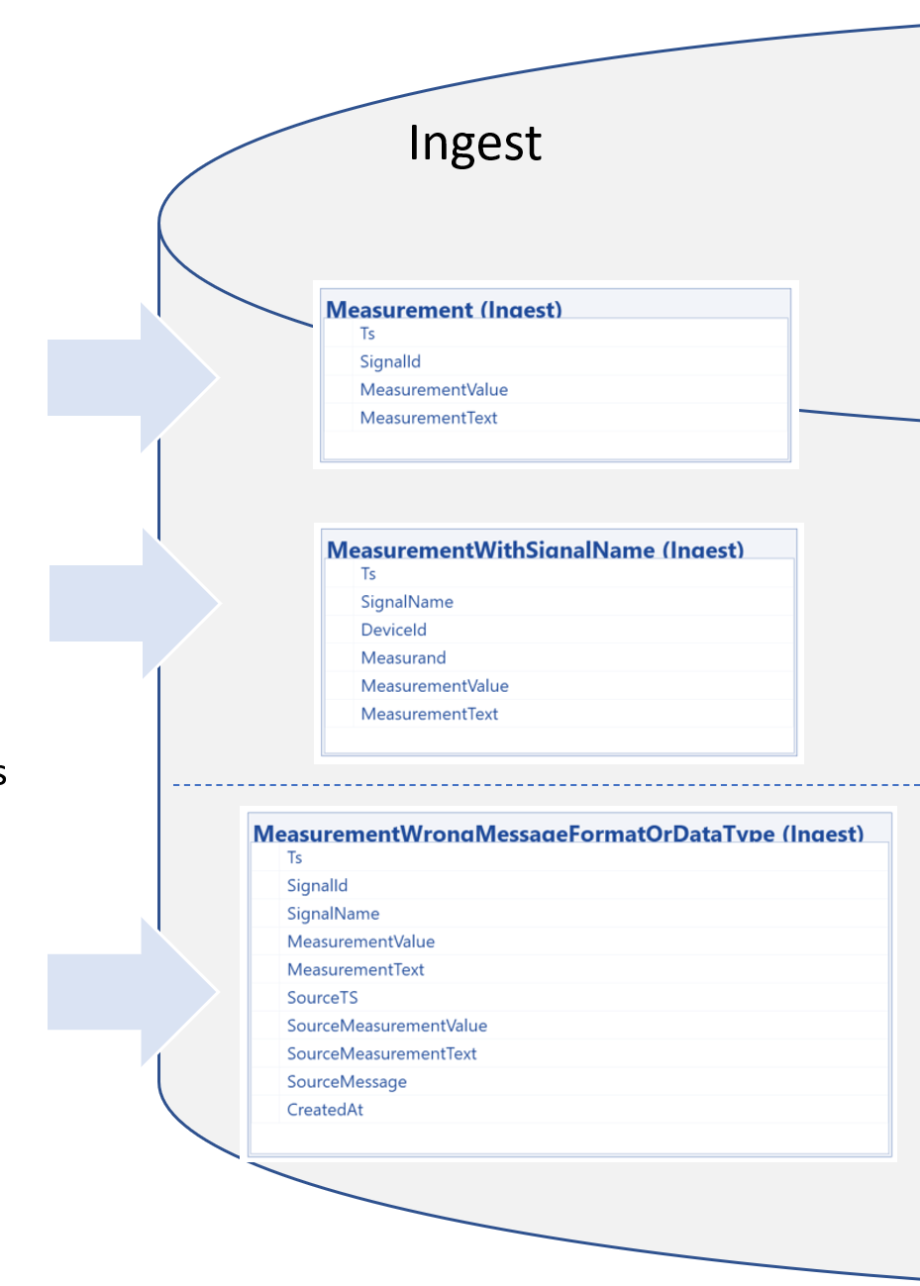
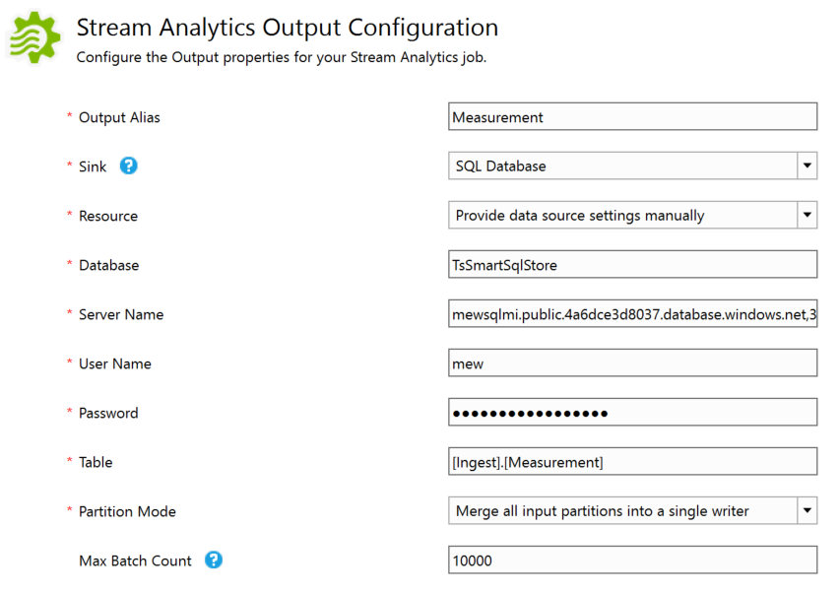
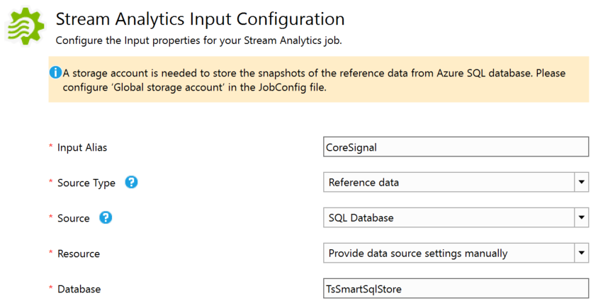
Define and Deploy Stream Analytics Job
3
Grant access to Azure Services
SELECT [SignalId], [SignalName]
FROM [Core].[Signal]

Slide 18
Define and Deploy Stream Analytics Job - 2
3
WITH IoTDataInputWithSignalName AS (SELECT
TRY_CAST(EventTimestamp AS DATETIME) AS [Ts]
,IoTHub.ConnectionDeviceId AS [DeviceId]
,SignalLabel AS [Measurand]
,CONCAT(IoTHub.ConnectionDeviceId, '_', SignalLabel) AS [SignalName]
,TRY_CAST([Value] AS FLOAT) AS [MeasurementValue]
,CASE WHEN LEN([Text]) > 0 THEN [Text]
ELSE NULL
END AS [MeasurementText]
,EventTimestamp AS [SourceTS]
,[Value] AS [SourceMeasurementValue]
,[Text] AS [SourceMeasurementText]
,[IoTDataInput] AS [SourceMessage]
FROM [IoTDataInput])
,IoTDataInputWithSignalId AS (SELECT [IoTInput].[Ts]
,[IoTInput].[DeviceId]
,[IoTInput].[Measurand]
,[CoreSignal].[SignalId]
,[IoTInput].[SignalName]
,[IoTInput].[MeasurementValue]
,[IoTInput].[MeasurementText]
,[IoTInput].[SourceTS]
,[IoTInput].[SourceMeasurementValue]
,[IoTInput].[SourceMeasurementText]
,[IoTInput].[SourceMessage]
FROM [IoTDataInputWithSignalName] AS [IoTInput]
LEFT OUTER JOIN [CoreSignal]
ON [IoTInput].[SignalName] = [CoreSignal].[SignalName] )
Message from IoT Hub
{
"EventTimestamp": "2021-12-08T14:01:14.5094082Z",
"SignalLabel": "Temperature",
"Value": "12.34",
"Text": "",
"EventProcessedUtcTime": "2021-12-08T14:01:14.5771421Z",
"PartitionId": 1,
"EventEnqueuedUtcTime": "2021-12-08T14:01:15.0040000Z",
"IoTHub": {
"MessageId": null,
"CorrelationId": null,
"ConnectionDeviceId": "mewTsSmartStartHubDevice001",
"ConnectionDeviceGenerationId": "637740536776612383",
"EnqueuedTime": "2021-12-08T14:01:15.0050000Z"
}
}
Device Message
{
"EventTimestamp": "2021-12-08T13:45:37.5349406Z",
"SignalLabel": "Humidity",
"Value": "67.26993883367159",
"Text": ""
}
Code depends on incoming message structure
“Generic” Code, try to resolve SignalName and provide SignalId

Slide 19
Define and Deploy Stream Analytics Job - 3
3
[MeasurementWrongMessageFormatOrDataType]
SELECT [Ts]
,[SignalId]
,[SignalName]
,[MeasurementValue]
,[MeasurementText]
,[SourceTS]
,[SourceMeasurementValue]
,[SourceMeasurementText]
,[SourceMessage]
INTO [MeasurementWrongMessageFormatOrDataType]
FROM [IoTDataInputWithSignalId]
WHERE [Ts] IS NULL
OR [SignalName] IS NULL
OR (([MeasurementValue] IS NULL)
AND ([MeasurementText] IS NULL)
)
“Generic Code”:
No timestamp or no SignalName or no “Payload”

Slide 20
Define and Deploy Stream Analytics Job - 4
3
[MeasurementWithSignalName]
SELECT [Ts]
,[SignalName]
,[DeviceId]
,[Measurand]
,[MeasurementValue]
,[MeasurementText]
INTO [MeasurementWithSignalName]
FROM [IoTDataInputWithSignalId]
WHERE [Ts] IS NOT NULL
AND ([MeasurementValue] IS NOT NULL
OR [MeasurementText] IS NOT NULL
)
AND [SignalName] IS NOT NULL
AND [SignalId] IS NULL
“Generic Code”:
Timestamp, SignalName and “Payload” is available, but no SignalId

Slide 21
Define and Deploy Stream Analytics Job - 5
3
[Measurement]
SELECT [IoTInput].[Ts]
,[CoreSignal].[SignalId] ,[IoTInput].[MeasurementValue]
,[IoTInput].[MeasurementText]
INTO [Measurement]
FROM [IoTDataInputWithSignalName] AS [IoTInput]
INNER JOIN [CoreSignal]
ON [IoTInput].[SignalName] = [CoreSignal].[SignalName]
WHERE [IoTInput].[Ts] IS NOT NULL
AND ([IoTInput].[MeasurementValue] IS NOT NULL
OR [IoTInput].[MeasurementText] IS NOT NULL )
“Generic Code”:
Timestamp, SignalId and “Payload” is available

Slide 22
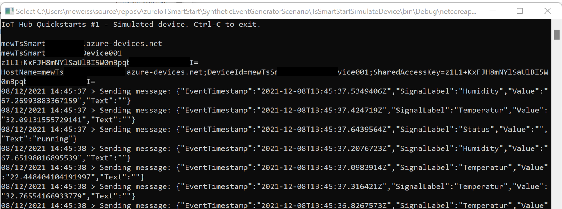
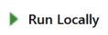
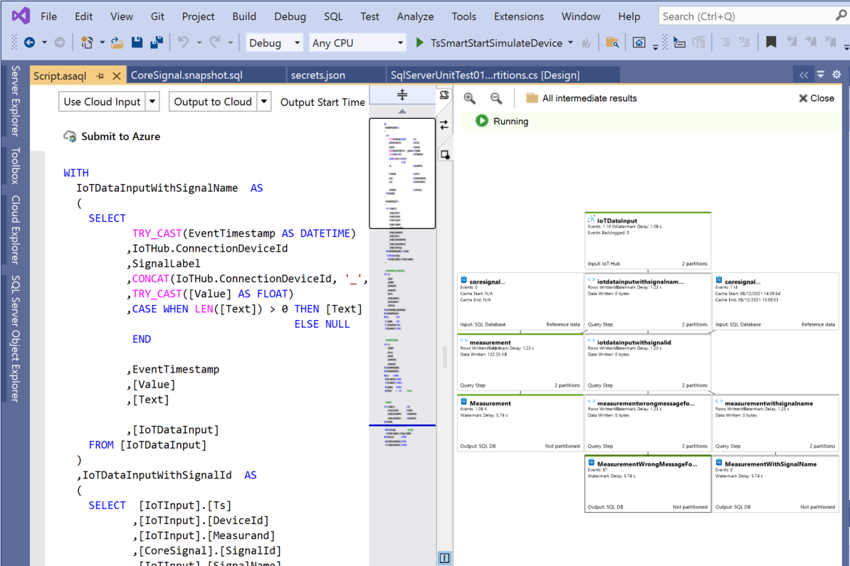
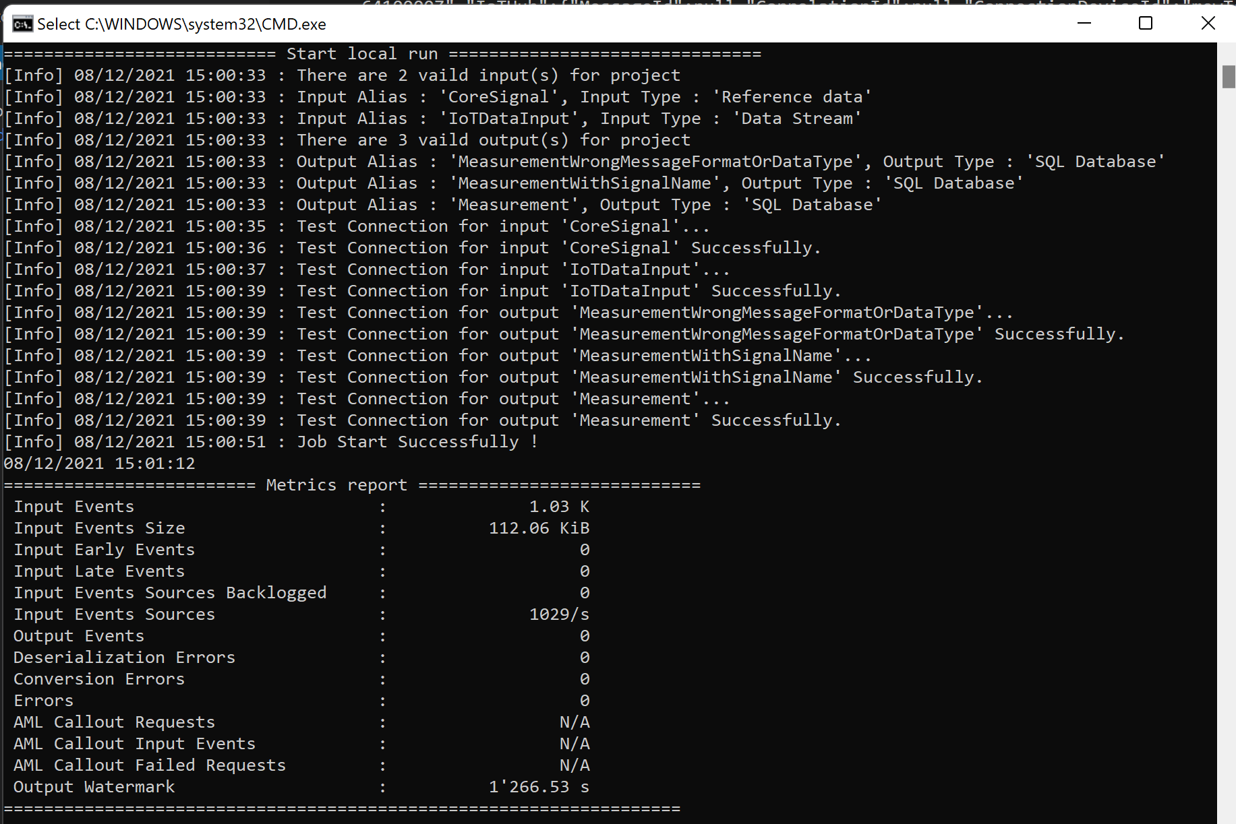
Test Setup in Visual Studio
TsSmartStartSimulateDevice
Build TsSmartStartSimulateDevice in Visual Studio
Open command prompt and move to your debug bin directory (.....\TsSmartStartSimulateDevice\bin\Debug\netcoreapp3.1)
Type: start TsSmartStartSimulateDevice.exe
TsSmartStreamAnalyticsJob
Define Use Cloud Input/Use Cloud Output and Click

Slide 23
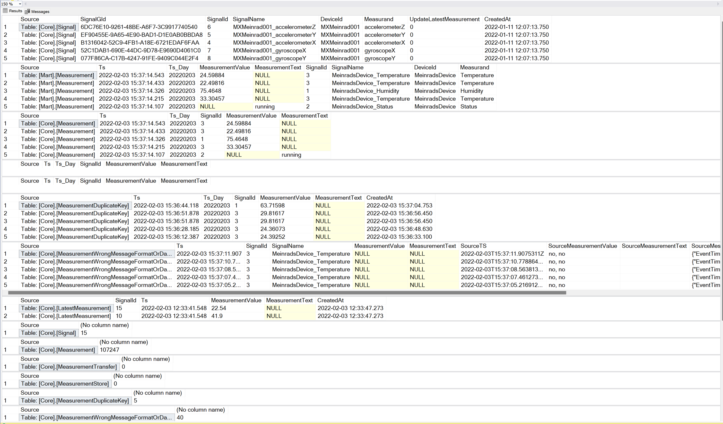
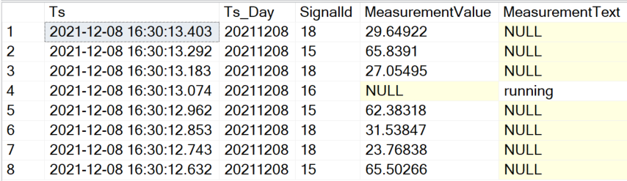
Check Data in Database
SELECT *
FROM [Core].[Signal]
SELECT top 8 *
FROM [Core].[Measurement]
ORDER BY [Ts] DESC
SELECT top 6 *
FROM [Core].[MeasurementWrongMessageFormatOrDataType]
ORDER BY [Ts] DESC
Stored Procedure:[Core].[GetOverviewOfDataInDatabase]

Slide 24
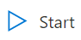
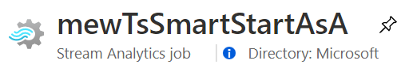
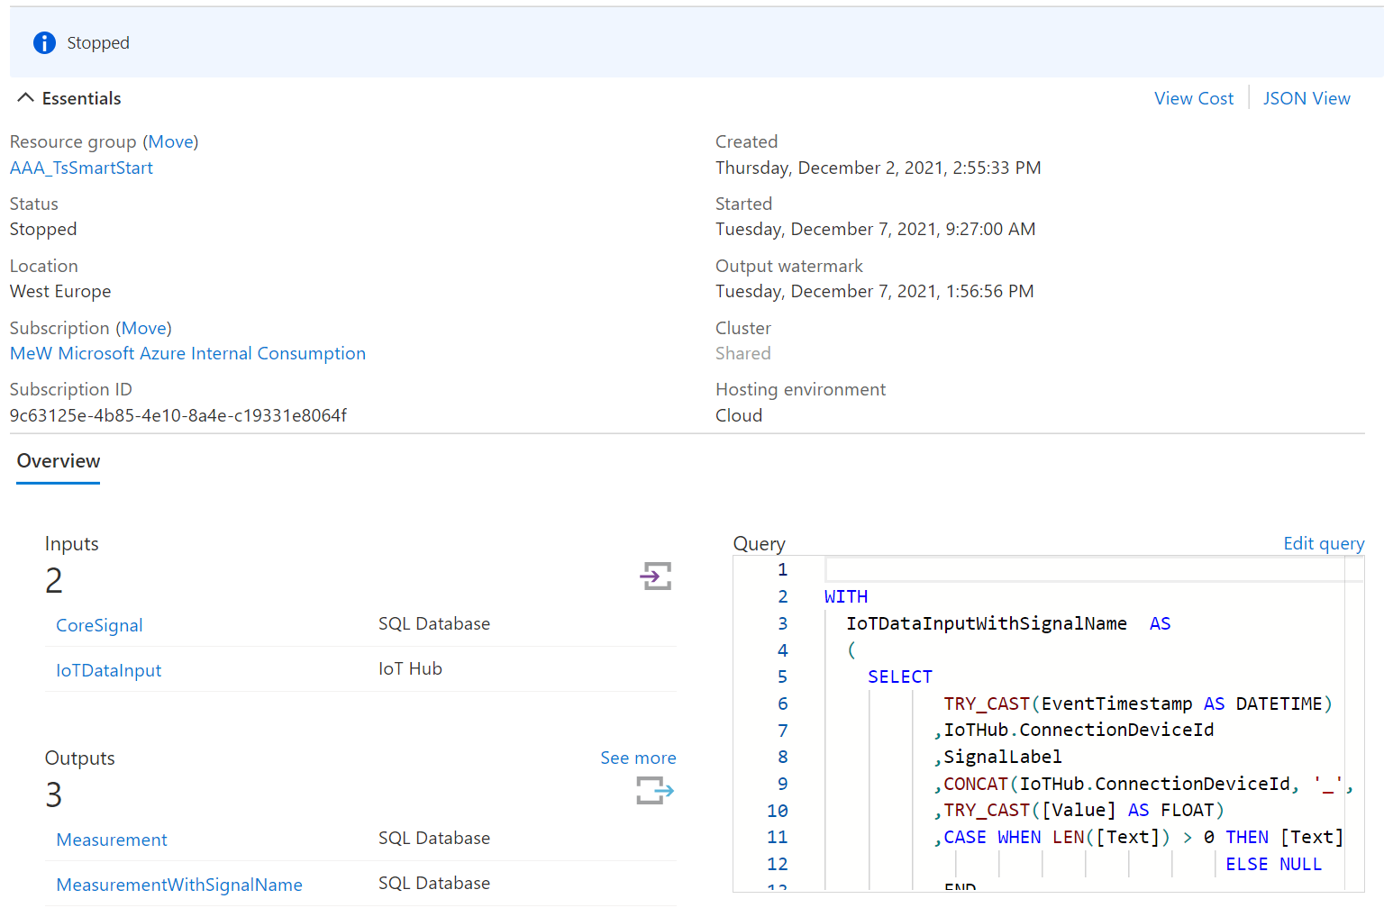
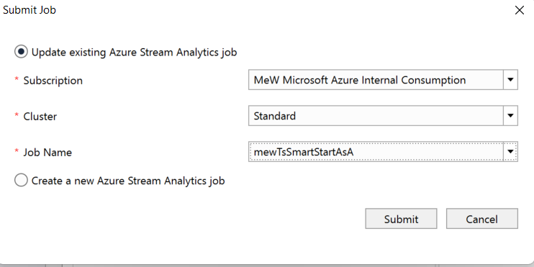
Deploy Stream Analytics Job
3
TsSmartStreamAnalyticsJob
Click

Slide 25
Ready to run
Ingest
Core
Mart
Stream Analytics

Slide 26
Agenda
Goal and Solution Overview
Deploy Solution
Internals
Auto Signal Registration
Handle Duplicate Values
Storage Details
Poor man’s digital twin
Restrict Data Access
Efficient Queries
Monitor activity/reset the database
Database Tiers
Conclusion and next Steps

Slide 27
More Details
Avoid duplicate delivery of events
(Keep them for quality control)
Deal with mal formed events
(Keep them for quality control)
Show data only allowed rows, company internal but also for third party users
IoT Hub
Stream Analytics
Azure SQL Database
Keep history of all security relevant meta data changes
Replace signal name with internal SignalId
Reference
Data

Slide 28
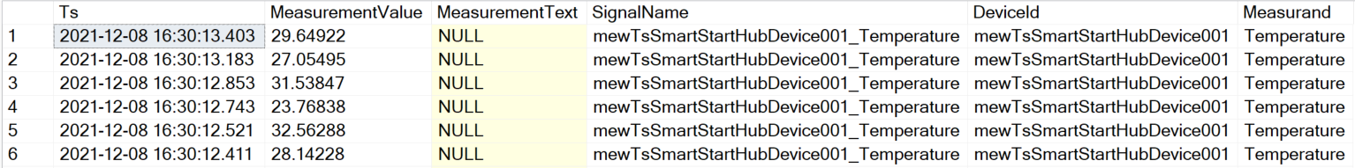
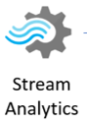
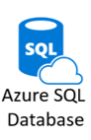

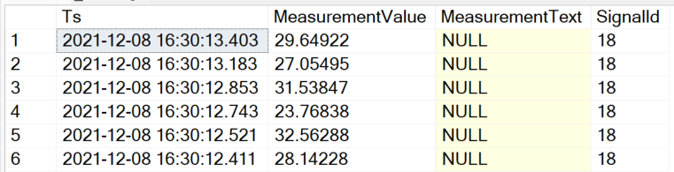
Signal Registration Process
[Ingest].[MeasurementWithSignalName]
{
"EventTimestamp": "2021-12-08T14:01:14.5094082Z",
"SignalLabel": "Temperature",
"Value": "12.34",
"Text": "",
"EventProcessedUtcTime": "2021-12-08T14:01:14.5771421Z",
"PartitionId": 1,
"EventEnqueuedUtcTime": "2021-12-08T14:01:15.0040000Z",
"IoTHub": {
"MessageId": null,
"CorrelationId": null,
"ConnectionDeviceId": "mewTsSmartStartHubDevice001",
"ConnectionDeviceGenerationId": "637740536776612383",
"EnqueuedTime": "2021-12-08T14:01:15.0050000Z"
}
}
[Ingest].[Measurement]

Slide 29
Main Azure SQL Database Structures
Instead of INSERT Trigger
Ingest
Core
Mart
Stream Analytics
Creates missing signals and stores them in [Core].[Signal]
Resolves [SignalId] and routes the event to [Ingest].[Measurement]

Slide 30
Auto Signal Registration
CREATE TRIGGER [Ingest].[IngestMeasurementWithSignalNameInsteadOfInsertTrigger]
ON [Ingest].[MeasurementWithSignalName]
INSTEAD OF INSERT
AS
SET NOCOUNT ON;
-- Insert missing signal name into Signal table
INSERT INTO [Core].[Signal]
([SignalName]
,[DeviceId]
,[Measurand])
SELECT DISTINCT [SignalName], [DeviceId], [Measurand]
FROM INSERTED
WHERE NOT EXISTS (SELECT 'X' FROM [Core].[Signal] AS s WHERE s.[SignalName] = INSERTED.[SignalName]);
-- Copy events to regular Measurement ingest facade
INSERT INTO [Ingest].[Measurement]
([Ts]
,[SignalId]
,[MeasurementValue]
,[MeasurementText])
SELECT [Ts]
,[SignalId]
,[MeasurementValue]
,[MeasurementText]
FROM INSERTED AS i
INNER JOIN [Core].[Signal] AS s
ON i.[SignalName] = s.[SignalName];
GO

Slide 31
Handle Duplicate Values
Event Delivery Guarantees (Azure Stream Analytics)
Exactly-once processing
Azure Stream Analytics guarantees exactly once processing.
Exactly-once delivery
Azure Stream Analytics guarantes at-least-once delivery to output sinks, which guarantees that all results are outputted, but duplicate results may occur. However exactly-once delivery may be achieved with several outputs such as Cosmos DB or SQL
The Azure instance is upgraded while the job is running
The Stream Analytics job is upgraded or an issue occurs with connectivity or reliability to the job output
The Azure instance running the job has an outage
Stream Analytics job is started with the when last stopped option

Slide 32
Handle Duplicate Values - 2
Cosmos DB
Using Cosmos DB, Azure Stream Analytics guarantees exactly-once delivery. Since Azure Stream Analytics uses upsert, no action is needed by the user. See more information on Azure Stream Analytics output to CosmosDB.
SQL
When using SQL output, users can achieve exactly-once delivery if the following requirements are met:
all output streaming events have a natural key, i.e. are uniquely identifiable either by a field or a combination of fields.
the output SQL table has a unique constraint (or primary key) created using the natural key of the output events.
This is sufficient to avoid duplicates because the SQL output honors any constraints placed on the table by skipping any events that cause a unique constraint violation.
Avoid duplicate delivery of events
(Keep them for quality control)
Just skipping means the fact that duplicates occurred disappears

Slide 33
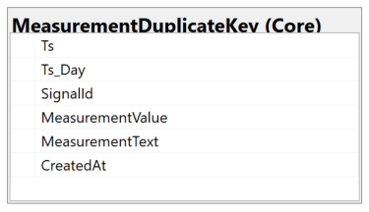
Handle Duplicate Values - 4
Instead of INSERT Trigger
Ingest
Core
Stream Analytics
Detect duplicate events and stores them in exception table [Core].[MeasurementDuplicateKey]
Calculates Partition Key Attribute and stores new events in [Core].[Measurement]

Slide 34
Handle Duplicate Values - 5
CREATE TRIGGER [Ingest].[IngestMeasurementInsteadOfInsertTrigger]
ON [Ingest].[Measurement]
INSTEAD OF INSERT
AS
SET NOCOUNT ON;
-- This is new
-- Store measurements that already exist in the duplicate key table.
INSERT INTO [Core].[MeasurementDuplicateKey]
( [Ts]
,[Ts_Day]
,[SignalId]
,[MeasurementValue]
,[MeasurementText]
,[CreatedAt])
SELECT
i.[Ts]
,CONVERT(INT, CONVERT(VARCHAR, i.[Ts], 112)) as Ts_Day -- Calculate partition Key
,CONVERT(INT, i.[SignalId])
,i.[MeasurementValue]
,i.[MeasurementText]
,GETDATE()
FROM INSERTED as i
INNER JOIN [Core].[AllMeasurement] as m
ON i.[SignalId] = m.[SignalId]
AND i.[Ts] = m.[Ts]
AND m.[Ts_Day] = CONVERT(INT, CONVERT(VARCHAR, i.[Ts], 112)); -- Enable partition elimination
...

Slide 35
Handle Duplicate Values – 5a
2nd part of TRIGGER [Ingest].[IngestMeasurementInsteadOfInsertTrigger]
...
-- Insert duplicate records if the happen in one batch of data
INSERT INTO [Core].[MeasurementDuplicateKey]
( [Ts]
,[Ts_Day]
,[SignalId]
,[MeasurementValue]
,[MeasurementText]
,[CreatedAt])
SELECT [INSERTED].[Ts]
,CONVERT(INT, CONVERT(VARCHAR, [INSERTED].[Ts], 112)) AS [Ts_Day] -- Calculate partition Key
,CONVERT(INT, [INSERTED].[SignalId]) AS [SignalId]
,[MeasurementValue]
,[MeasurementText]
,GETDATE()
FROM [INSERTED]
INNER JOIN (SELECT i.[Ts]
,i.[SignalId]
,COUNT(*) as c
FROM INSERTED as i
GROUP BY i.[Ts]
,i.[SignalId]
HAVING COUNT(*) > 1
) AS DUPLICATE_ROWS
ON [INSERTED].[Ts] = [DUPLICATE_ROWS].[Ts]
AND [INSERTED].[SignalId] = [DUPLICATE_ROWS].[SignalId]

Slide 36
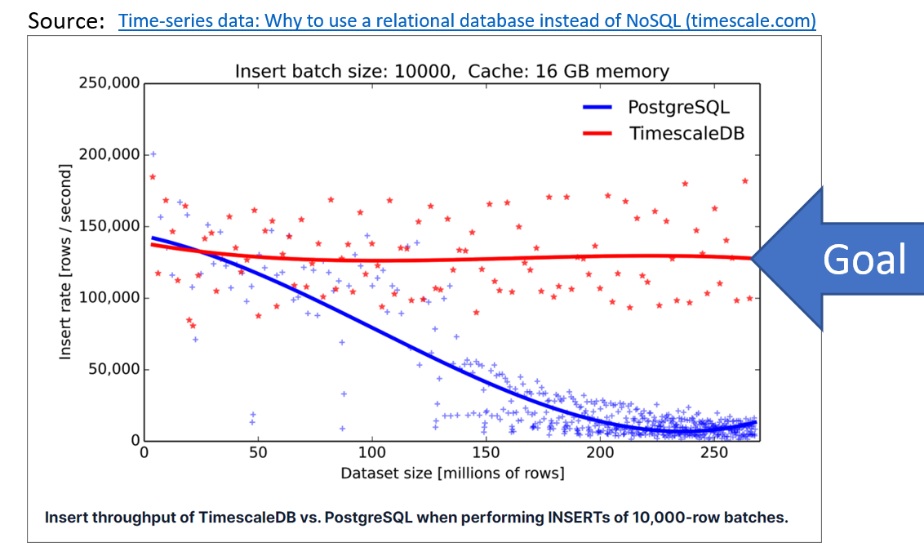




Storage Details – Basic Usage
IoT data arrives in batches
“ordered by” Ts
The typical query for Time Series data is:
select [Ts], [SignalId], [MeasurementValue]
from [Core].[Measurement]
where [SignalId] = 15
AND [Ts] between '2021-12-08 16:30:05' and '2021-12-08 16:30:10.876'
order by SignalId, TS
The index will be extremely fragmented
after a few inserts
ALTER TABLE [Core].[Measurement]
ADD CONSTRAINT [PK_Core_Measurement] PRIMARY KEY CLUSTERED
([SignalId] ASC,
[Ts] DESC,
[Ts_Day] DESC
)
[Core].[Measurement]
[Core].[Measurement]
Today -2
Today -2
Today -1
Today -1
New data
Today
New data
Today
EXEC [Core].[RebuildFragmentedIndexes]
Fragmented
Not fragmented

Slide 37

Storage Details – Basic Usage -2
Day Partition Objects
CREATE TABLE [Core].[Measurement] (
[Ts] DATETIME2 (3) NOT NULL,
[Ts_Day] DATETIME2 (0) NOT NULL,
[SignalId] INT NOT NULL,
[MeasurementValue] REAL NULL,
[MeasurementText] NVARCHAR (4000) NULL,
[CreatedAt] DATETIME2(3) NULL,
CONSTRAINT [PK_Core_Measurement] PRIMARY KEY CLUSTERED ([SignalId] ASC, [Ts] DESC, [Ts_Day] DESC) WITH (DATA_COMPRESSION = PAGE) ON [dayPartitionScheme] ([Ts_Day]),
CONSTRAINT [FK_Core_Measurement_Signal] FOREIGN KEY ([SignalId]) REFERENCES [Core].[Signal] ([SignalId])
) ON [dayPartitionScheme] ([Ts_Day]);
CREATE PARTITION SCHEME [dayPartitionScheme] AS PARTITION [dayPartitionFunction]
TO ([PRIMARY], [PRIMARY]);
Partition 1: > 1900-01-01 00:00:00
Partition 2: >= 1900-01-01 00:00:00
1900-01-01 OO:00:00
EXECUTE [Partition].[MaintainPartitionBorders]
CREATE PARTITION FUNCTION [dayPartitionFunction](INT)
AS RANGE RIGHT FOR VALUES ('1900.01.01');
Creates new partitions for the upcoming days (~ + 40 days in future)

Slide 38
Storage Details – Advanced Usage
For large data history, day partitioning leads to too many partitions
There is a mixed model with day and month partitions
[Core].[OptimiseDataStorage]
Table: [Core].[MeasurementStore]
(Month partition)
View:
[Core].[AllMeasurement]
Table:
[Core].[Measurement]
(Day partition)
A 45.0
B 12.1
C 77.4
A 47.0
B 22.1
C 55.1
A 45.5
B 15.5
D 11.4
A 55.1
B 22.1
C 78.5
A 45.4
B 42.1
D 15.4
A 45.1
B 12.5
C 77.8
A 35.0
B 15.1
C 75.5
A 45.3
B 18.9
C 67.4
20210128
20210129
20210130
20210131
20210202
20210203
20210204
…
20210201
20210301

Slide 39
Storage Details – Advanced Usage
For large data history, day partitioning leads to too many partitions
There is a mixed model with day and month partitions
[Core].[OptimiseDataStorage]
A 45.0
B 12.1
C 77.4
A 47.0
B 22.1
C 55.1
A 45.5
B 15.5
D 11.4
A 45.4
B 42.1
D 15.4
Table: [Core].[MeasurementStore]
(Month partition)
A 55.1
B 22.1
C 78.5
Table: [Core].[MeasurementTransfer]
(Month partition)
[Core].[OptimiseDataStorage]
View:
[Core].[AllMeasurement]
Step 1: Partition Switch
Table:
[Core].[Measurement]
(Day partition)
A 45.1
B 12.5
C 77.8
A 35.0
B 15.1
C 75.5
A 45.3
B 18.9
C 67.4
20210128
20210129
20210130
20210131
20210202
20210203
20210204
…
20210201
20210301

Slide 40
Storage Details – Advanced Usage
For large data history, day partitioning leads to too many partitions
There is a mixed model with day and month partitions
[Core].[OptimiseDataStorage]
A 45.0
B 12.1
C 77.4
A 47.0
B 22.1
C 55.1
A 45.5
B 15.5
D 11.4
A 45.4
B 42.1
D 15.4
Table: [Core].[MeasurementStore]
(Month partition)
A 55.1
B 22.1
C 78.5
Table: [Core].[MeasurementTransfer]
(Month partition)
A 45.1
B 12.5
C 77.8
[Core].[OptimiseDataStorage]
View:
[Core].[AllMeasurement]
Step 1: Partition Switch
Table:
[Core].[Measurement]
(Day partition)
C 69.0
A 29.0
A 35.0
B 15.1
C 75.5
A 45.3
B 18.9
C 67.4
20210128
20210129
20210130
20210131
20210202
20210203
20210204
…
20210201
20210301

Slide 41
Storage Details – Advanced Usage
For large data history, day partitioning leads to too many partitions
There is a mixed model with day and month partitions
[Core].[OptimiseDataStorage]
A 45.0
B 12.1
C 77.4
A 47.0
B 22.1
C 55.1
A 45.5
B 15.5
D 11.4
A 45.4
B 42.1
D 15.4
Table: [Core].[MeasurementStore]
(Month partition)
A 55.1
B 22.1
C 78.5
Step 2: Copy rows
Table: [Core].[MeasurementTransfer]
(Month partition)
A 45.1
B 12.5
C 77.8
[Core].[OptimiseDataStorage]
View:
[Core].[AllMeasurement]
Step 1: Partition Switch
Table:
[Core].[Measurement]
(Day partition)
C 69.0
A 29.0
A 35.0
B 15.1
C 75.5
A 45.3
B 18.9
C 67.4
20210128
20210129
20210130
20210131
20210202
20210203
20210204
…
20210201
20210301
EXEC [Core].[CopyMeasurementFromTs_DayToTs_Day] @FromTs_Day = 20211211, @MoveDaysBack = 14, @OffsetMillisecond = 1
Helpful SP to generate test data
Notes:
EXEC [Core].[OptimiseDataStorage]
EXEC [Core].[CopyMeasurementFromTs_DayToTs_Day] @FromTs_Day = 20211211, @MoveDaysBack = 14, @OffsetMillisecond = 1

Slide 42
Storage Details – Advanced Usage -2
CREATE TABLE [Core].[MeasurementStore] (
[Ts] DATETIME2 (3) NOT NULL,
[Ts_Day] INT NOT NULL,
[SignalId] INT NOT NULL,
[MeasurementValue] REAL NULL,
[MeasurementText] NVARCHAR (4000) NULL
) ON [monthPartitionScheme] ([Ts_Day]);
CREATE NONCLUSTERED INDEX [NCIX_CoreMeasurementStoreTsTs_DaySignalId]
ON [Core].[MeasurementStore]([Ts] ASC, [Ts_Day] ASC, [SignalId] ASC) WITH (DATA_COMPRESSION = PAGE)
ON [monthPartitionScheme] ([Ts_Day]);
CREATE CLUSTERED COLUMNSTORE INDEX [CCI_Core_MeasurementStore]
ON [Core].[MeasurementStore]
ON [monthPartitionScheme] ([Ts_Day]);
Notes:
Check if attribute order in non clustered index makes sense

Slide 43



Quick Overview of data in the database
EXEC [Core].[GetOverviewOfDataInDatabase]

Slide 44




Remove Data from Measurement<XXX> table
EXECUTE [Partition].[RemoveDataPartitionsFromTable]
@SchemaName = 'Core'
,@TableName = 'MeasurementStore'
,@TS_Day_LowWaterMark = 20211201
,@TS_Day_HighWaterMark = 20211231
,@PreserveSwitchOutTable = 1
Table: [Core].[MeasurementStore]
(Month partition)
A 45.0
B 12.1
C 77.4
A 47.0
B 22.1
C 55.1
A 45.5
B 15.5
D 11.4
A 55.1
B 22.1
C 78.5
View:
[Core].[AllMeasurement]
Table:
[Core].[Measurement]
(Day partition)
A 45.4
B 42.1
D 15.4
A 45.1
B 12.5
C 77.8
A 35.0
B 15.1
C 75.5
A 45.3
B 18.9
C 67.4
20211228
20211229
20211230
20211231
20220102
20220103
20220104
…
20220101
20220201
[Core].[SwitchedOut_MeasurementStore_20211201_2021-12-14T18:53:05.363]

Slide 45


Remove Data from Measurement<XXX> table -2
EXECUTE [Partition].[RemoveDataPartitionsFromTable]
@SchemaName = 'Core'
,@TableName = 'Measurement'
,@TS_Day_LowWaterMark = 20211214
,@TS_Day_HighWaterMark = 20211214
,@PreserveSwitchOutTable = 1
GO

Slide 46
Agenda
Goal and Solution Overview
Deploy Solution
Internals
Auto Signal Registration
Handle Duplicate Values
Storage Details
Poor man’s digital twin
Restrict Data Access
Efficient Queries
Monitor activity/reset the database
Database Tiers
Conclusion and next Steps

Slide 47

Poor man’s digital twin
The question “What is the last know value of a given Signal” can not use “Partition Elimination”
The Table [Core].[LatestMeasurement] contains the latest know value
If [UpdateLatestMeasurement] is set to «true» in [Core].[Signal]
Keeping the table up to date adds some overhead to the system -> update can be enabled if required
Also, helpful to see end-to-end latency of the whole chain

Slide 48
Agenda
Goal and Solution Overview
Deploy Solution
Internals
Auto Signal Registration
Handle Duplicate Values
Storage Details
Poor man’s digital twin
Restrict Data Access
Efficient Queries
Monitor activity/reset the database
Database Tiers
Conclusion and next Steps

Slide 49
Data ingest and presentation
Avoid duplicate delivery of events
(Keep them for quality control)
Deal with mal formed events
(Keep them for quality control)
Show data only allowed rows, company internal but also for third party users
IoT Hub
Stream Analytics
Azure SQL Database
Keep history of all security relevant meta data changes
Replace signal name with internal SignalId
Reference
Data

Slide 50
Azure SQL Database
Ingest
Core
Mart
Stream Analytics
Row level security

Slide 51
Row level security
CREATE FUNCTION [Security].[fn_datapointsecuritypredicate]
(@DataPointId AS int)
RETURNS TABLE
WITH SCHEMABINDING
AS
RETURN SELECT 1 AS fn_datapointsecuritypredicate_result
WHERE (@DataPointId
IN (
-- REGULAR USER
SELECT DISTINCT [DataPointId]
FROM [Security].[ApplicationRoleDataPointAccess]
INNER JOIN [Security].[ApplicationRoleMember]
ON [ApplicationRoleDataPointAccess].[RoleId] = [ApplicationRoleMember].[RoleId]
WHERE [ApplicationRoleMember].[UserId] = SYSTEM_USER
)
)
OR
( -- ADMIN USER EXISTS (SELECT 'x' FROM [Security].[ApplicationRoleMember]
WHERE [RoleId] = 'ApplicationAdmin'
AND [UserId] = SYSTEM_USER)
)
CREATE SECURITY POLICY [dbo].[DataPointFilter]
ADD FILTER PREDICATE [Security].[fn_datapointsecuritypredicate]([SignalId])
ON [Core].[Signal]
WITH (STATE = ON, SCHEMABINDING = ON)

Slide 52

Security related tables

Slide 53
Performance Optimization(Unique Key reference)
CREATE TABLE [Security].[ApplicationUser]
(
[ApplicationUserGId] UNIQUEIDENTIFIER NOT NULL DEFAULT NEWID(),
[UserId] [sysname] NOT NULL CONSTRAINT [UK_Security_ApplicationUser_UserId] UNIQUE([UserId]),
[Remark] VARCHAR (255) NULL,
[CreatedBy] [sysname] NOT NULL CONSTRAINT [df_Security_ApplicationUser_createdby] DEFAULT (suser_sname()),
[ValidFrom] DATETIME2 (7) GENERATED ALWAYS AS ROW START
NOT NULL,
[ValidTo] DATETIME2 (7) GENERATED ALWAYS AS ROW END
NOT NULL,
PRIMARY KEY NONCLUSTERED ([ApplicationUserGId] ASC),
PERIOD FOR SYSTEM_TIME ([ValidFrom], [ValidTo])
)
WITH (SYSTEM_VERSIONING = ON (HISTORY_TABLE=[Security].[ApplicationUserHistory], DATA_CONSISTENCY_CHECK=ON));
CREATE TABLE [Security].[ApplicationRoleMember] (
[ApplicationRoleMemberGId] UNIQUEIDENTIFIER NOT NULL DEFAULT NEWID(),
[RoleId] [sysname] NOT NULL,
[UserId] [sysname] NOT NULL,
[Remark] VARCHAR (255) NULL,
[CreatedBy] [sysname] NOT NULL CONSTRAINT [df_rolemember_createdby] DEFAULT (suser_sname()),
[ValidFrom] DATETIME2 (7) GENERATED ALWAYS AS ROW START NOT NULL,
[ValidTo] DATETIME2 (7) GENERATED ALWAYS AS ROW END NOT NULL,
CONSTRAINT [PK_security_applicationrolemember] PRIMARY KEY NONCLUSTERED ([ApplicationRoleMemberGId] ASC),
CONSTRAINT [UK_security_applicationrolemember] UNIQUE CLUSTERED ([UserId] ASC, [RoleId] ASC),
CONSTRAINT [FK_ApplicationRoleMember_ApplicationRole] FOREIGN KEY ([RoleId]) REFERENCES [Security].[ApplicationRole] ([RoleId]),
CONSTRAINT [FK_ApplicationRoleMember_ApplicationUser] FOREIGN KEY ([UserId]) REFERENCES [Security].[ApplicationUser] ([UserId]),
PERIOD FOR SYSTEM_TIME ([ValidFrom], [ValidTo])
)
WITH (SYSTEM_VERSIONING = ON (HISTORY_TABLE=[Security].[ApplicationRoleMemberHistory], DATA_CONSISTENCY_CHECK=ON));

Slide 54

Temporal Table for Security related tables
CREATE TABLE [Security].[ApplicationUser]
(
[ApplicationUserGId] UNIQUEIDENTIFIER NOT NULL DEFAULT NEWID(),
[UserId] [sysname] NOT NULL CONSTRAINT [UK_Security_ApplicationUser_UserId] UNIQUE([UserId]),
[Remark] VARCHAR (255) NULL,
[CreatedBy] [sysname] NOT NULL CONSTRAINT [df_Security_ApplicationUser_createdby] DEFAULT (suser_sname()),
[ValidFrom] DATETIME2 (7) GENERATED ALWAYS AS ROW START
NOT NULL,
[ValidTo] DATETIME2 (7) GENERATED ALWAYS AS ROW END
NOT NULL,
PRIMARY KEY NONCLUSTERED ([ApplicationUserGId] ASC),
PERIOD FOR SYSTEM_TIME ([ValidFrom], [ValidTo])
)
WITH (SYSTEM_VERSIONING = ON (HISTORY_TABLE=[Security].[ApplicationUserHistory], DATA_CONSISTENCY_CHECK=ON));

Slide 55
Agenda
Goal and Solution Overview
Deploy Solution
Internals
Auto Signal Registration
Handle Duplicate Values
Storage Details
Poor man’s digital twin
Restrict Data Access
Efficient Queries
Monitor activity/reset the database
Database Tiers
Conclusion and next Steps

Slide 56
Effizient Queries
Partition elimination is key
declare @FromTs DATETIME = '2021-12-11 12:37:57.119'
,@ToTs DATETIME = '2021-12-11 13:37:57.119'
,@SignalId INT = 1
SELECT *
FROM [Core].[AllMeasurement]
WHERE [SignalId] = @SignalId
AND [Ts_Day] >= CONVERT(INT, CONVERT(VARCHAR, @FromTs, 112))
AND [Ts_Day] <= CONVERT(INT, CONVERT(VARCHAR, @ToTs, 112))
AND [Ts] >= @FromTs
AND [Ts] <= @ToTs
SELECT *
FROM [Mart].[GetMeasurementForSignal] (1 ,'2021-12-11 12:37:57.119' ,'2021-12-11 13:37:57.119')
Table: [Core].[MeasurementStore]
(Month partition)
A 45.0
B 12.1
C 77.4
A 47.0
B 22.1
C 55.1
A 45.5
B 15.5
D 11.4
View:
[Core].[AllMeasurement]
Table:
[Core].[Measurement]
(Day partition)
A 55.1
B 22.1
C 78.5
A 45.4
B 42.1
D 15.4
A 45.1
B 12.5
C 77.8
A 35.0
B 15.1
C 75.5
A 45.3
B 18.9
C 67.4
20210128
20210129
20210130
20210131
20210202
20210203
20210204
…
20210201
20210301

Slide 57
Efficient Queries and Power BI – Direct Query
CREATE FUNCTION [Mart].[GetMeasurementForRelativeTimeWindow]
( @DeltaTime VARCHAR(25)
,@EndDateTime DATETIME2(3) = NULL)
RETURNS TABLE
AS
RETURN
SELECT
[Ts] AS [UctTs]
,CONVERT(DATETIME2(3),CONVERT(DATETIMEOFFSET, [Ts]) AT TIME ZONE 'Central European Standard Time') AS [CetTs]
,[Ts_Day] AS [UctTs_Day]
,[SignalId]
,[MeasurementValue]
,[MeasurementText]
,CONVERT(DATE, Ts) AS [UctTs_Daypart]
-- CONVERT(VARCHAR(12) is required to be able to zoom in PowerBI below seconds
,CONVERT(VARCHAR(12), CONVERT(TIME(3), Ts, 121)) AS [UctTs_Timepart]
,CONVERT(DATE, CONVERT(DATETIMEOFFSET, [Ts]) AT TIME ZONE 'Central European Standard Time') AS [CetTs_Daypart]
-- CONVERT(VARCHAR(12) is required to be able to zoom in PowerBI below seconds
,CONVERT(VARCHAR(12), CONVERT(time(3), CONVERT(DATETIMEOFFSET, [Ts]) AT TIME ZONE 'Central European Standard Time')) AS [CetTs_Timepar]
FROM [Core].[AllMeasurement]
CROSS JOIN [Mart].[GetRelativeTimeWindow] (@DeltaTime, @EndDateTime)
WHERE [Ts_Day] >= [UtcTs_DayStartDate]
AND [Ts_Day] <= [UtcTs_DayEndDate]
AND [Ts] >= [UtcStartDateTime]
AND [Ts] <= [UtcEndDateTime]
Dynamic M-Parameter

Slide 58



Efficient Queries and Power BI – Direct Query
CREATE FUNCTION [Mart].[GetMeasurementForRelativeTimeWindow]
( @DeltaTime VARCHAR(25)
,@EndDateTime DATETIME2(3) = NULL)
RETURNS TABLE
AS
RETURN
SELECT
[Ts] AS [UctTs]
,CONVERT(DATETIME2(3),CONVERT(DATETIMEOFFSET, [Ts]) AT TIME ZONE 'Central European Standard Time') AS [CetTs]
,[Ts_Day] AS [UctTs_Day]
,[SignalId]
,[MeasurementValue]
,[MeasurementText]
,CONVERT(DATE, Ts) AS [UctTs_Daypart]
-- CONVERT(VARCHAR(12) is required to be able to zoom in PowerBI below seconds
,CONVERT(VARCHAR(12), CONVERT(TIME(3), Ts, 121)) AS [UctTs_Timepart]
,CONVERT(DATE, CONVERT(DATETIMEOFFSET, [Ts]) AT TIME ZONE 'Central European Standard Time') AS [CetTs_Daypart]
-- CONVERT(VARCHAR(12) is required to be able to zoom in PowerBI below seconds
,CONVERT(VARCHAR(12), CONVERT(time(3), CONVERT(DATETIMEOFFSET, [Ts]) AT TIME ZONE 'Central European Standard Time')) AS [CetTs_Timepar]
FROM [Core].[AllMeasurement]
CROSS JOIN [Mart].[GetRelativeTimeWindow] (@DeltaTime, @EndDateTime)
WHERE [Ts_Day] >= [UtcTs_DayStartDate]
AND [Ts_Day] <= [UtcTs_DayEndDate]
AND [Ts] >= [UtcStartDateTime]
AND [Ts] <= [UtcEndDateTime]
Dynamic M-Parameter

Slide 59
Agenda
Goal and Solution Overview
Deploy Solution
Internals
Auto Signal Registration
Handle Duplicate Values
Storage Details
Poor man’s digital twin
Restrict Data Access
Efficient Queries
Monitor activity/reset the database
Database Tiers
Conclusion and next Steps

Slide 60


Monitor Activites
Important operations are logged in the two tables:
[Logging].[TaskLog]
[Logging].[StepLog]
Combined in View [Logging].[LogInfo]
SELECT * FROM [Logging].[TaskLog]
SELECT * FROM [Logging].[StepLog]

Slide 61
Reset the database
Data from the following tables
[Core].[Signal]
[Core].[Measurement]
[Core].[MeasurementTransfer]
[Core].[MeasurementStore]
[Core].[MeasurementDuplicateKey]
[Core].[MeasurementWrongMessageFormatOrDataType]
[Core].[OptimizerInfo]
[Logging].[TaskLog]
[Logging].[StepLog]
can be deleted with the stored procedure
[Partition].[EmptyAllDataTablesYesImConfidentToDo]
The two sequences will also be reset to a start value of 1
[Core].[Id]
[Logging].[LogSequence]
Restart Stream Analytics after a reset, to update cached meta data!

Slide 62
Data ingest and presentation
Instead of Trigger “API – View Layer”
~ 20 lines of T-SQL code
Stream Analytics
~ 20 lines of SQL code
Declarative Row Level Security
~ 20 lines of T-SQL code
Avoid duplicate delivery of events
(Keep them for quality control)
Deal with mal-formed events
(Keep them for quality control)
Show data only allowed rows, company internal but also for third party users
IoT Hub
Stream Analytics
Azure SQL Database
Keep history of all security relevant meta data changes
Replace signal name with internal SignalId
Reference
Data
Temporal Tables
0 lines of T-SQL code
Reference Data in Stream Analytics
~ 5 lines of SQL code

Slide 63
Agenda
Goal and Solution Overview
Deploy Solution
Internals
Auto Signal Registration
Handle Duplicate Values
Storage Details
Poor man’s digital twin
Restrict Data Access
Efficient Queries
Monitor activity/reset the database
Database Tiers
Conclusion and next Steps

Slide 64








Relational
SQL
SQL
MySQL
PostgreSQL
MariaDB
SQL Server in Azure
SQL Server Hyperscale
Azure SQL Data Warehouse
Key-Value, Documents, …
MongoDB API
Table API
Non
Relational
Azure Cosmos DB
Files
Hadoop
Databricks
Azure Data Lake Storage
Some GB to a few TB
Many TB
to some PB

Slide 65




Azure SQL Database Family
Azure SQL DB
Azure SQL Server Hyperscale
Azure Synapse Analytics SQL Pool
DB
[Cache]
Azure SQL Serverless

Slide 66

Scalability
Build your full-PaaS IoT solution with Azure SQL Database - Microsoft Tech Community
Scaling up an IoT workload using an M-series Azure SQL database - Microsoft Tech Community

Slide 67
Current Data Volume (after ~ 6 months up and running)
20’000’000 events per day
Avg 230 events per second
Peak 20’000 events per second
3'881'478'093 events currently stored in database
Multiple ML Jobs running in the background
~ 20 Interactive Users

Slide 68


Slide 69



Slide 70

Current Scale Level

Slide 71


Utilization

Slide 72
Agenda
Goal and Solution Overview
Deploy Solution
Internals
Auto Signal Registration
Handle Duplicate Values
Storage Details
Poor man’s digital twin
Restrict Data Access
Efficient Queries
Monitor activity/reset the database
Database Tiers
Conclusion and next Steps

